Slide 1
the Kali Linux Operating System
Muhammed Onur Kaya

Slide 2
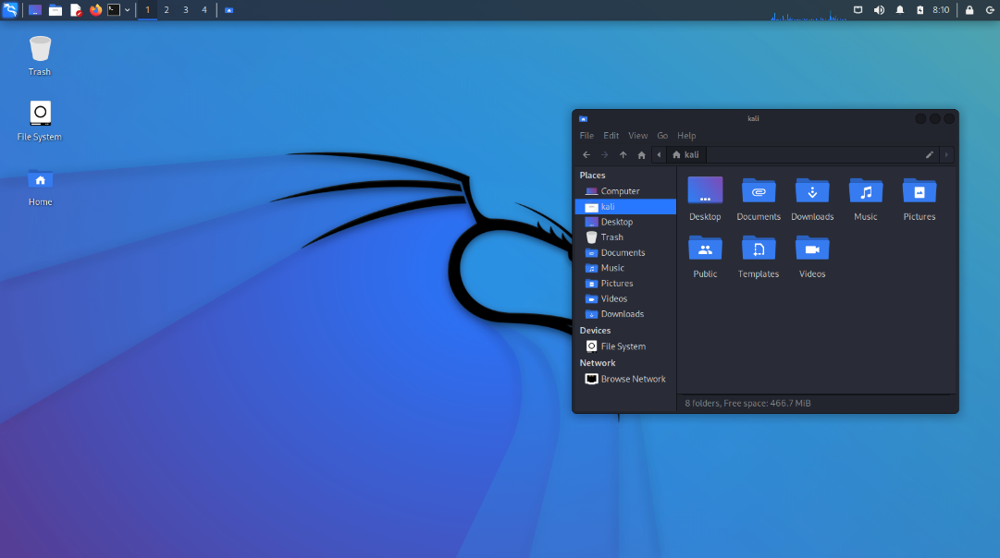
What is Kali Linux?
Kali Linux is a Linux distribution used especially in areas such as cyber security and penetration testing. Its advantages over Windows are:
open source and free operating system
Kali Linux comes with pre-installed cybersecurity tools
More secure than Windows
Customizability
Update and patch support

Slide 3
This operating system includes many different tools and programs, some of which are:
1-Penetration Tests: Contains many tools for performing penetration tests on computer networks and systems .
2-Data Recovery: It can be used to recover deleted or lost data. Tools for this process are used to scan your hard drives, flash drives, SSDs and other storage devices and recover deleted data .
3-Network Analysis: These tools are used to analyze network traffic, collect information by scanning the devices discovered on the network, and identify security vulnerabilities on the network .
4-Password Cracking : Contains many tools to crack passwords . These tools are used to crack encrypted files, Wi -Fi networks, system administrator accounts and other encrypted devices .
5-Remote Access: It contains many tools for remote access . These tools are used to connect to a remote computer system, gain access and act on the target system .
6-Encryption : Kali Linux also includes encryption tools. These tools are used to encrypt your files and disks, encrypt your messages, or establish encrypted communication.

Slide 4
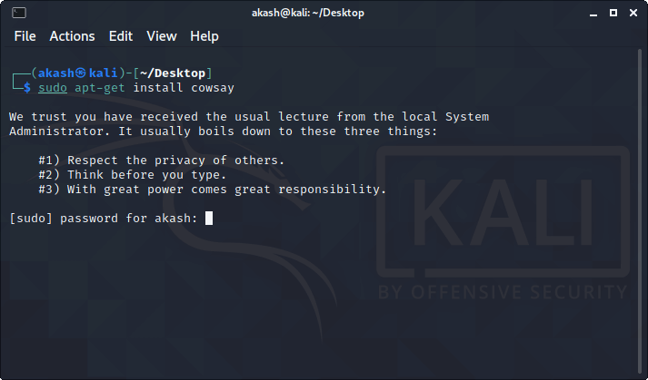
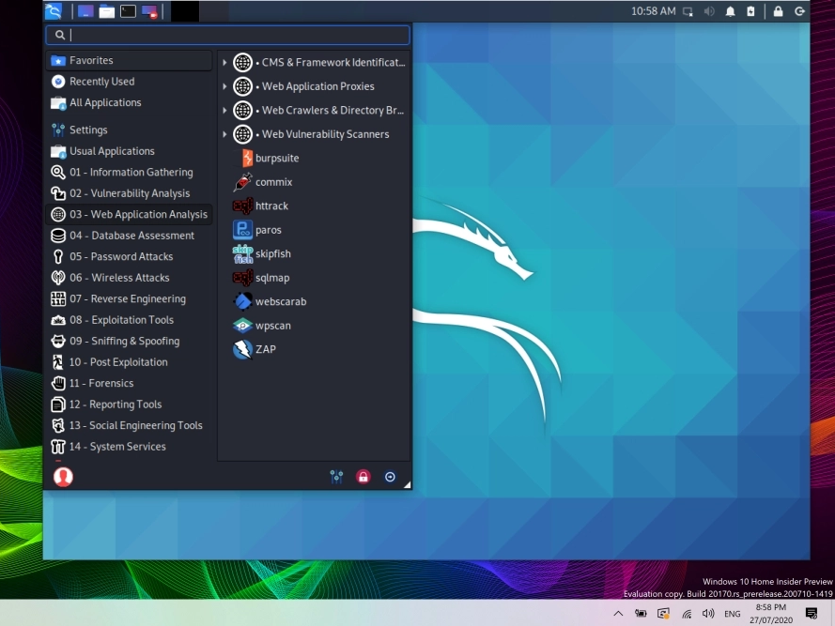
Kali Linux terminal and start window

Slide 5
Here are some basic commands that everyone should know when using Kali Linux:
ls : This command lists files and folders in the current directory.
cd: This command allows you to change to a different directory within the current directory.
pwd : This command shows the full path of the current directory.
mkdir : This command allows you to create a new directory.
ps : This command lists running processes.
kill : This command kills the specified process.
ifconfig : This command shows the configuration of network interfaces .
ping : This command pings an IP address or a domain name and displays the response.
netstat : This command lists network connections and ports on the network.
apt-get : This command checks package management and installs.

